Slide 1

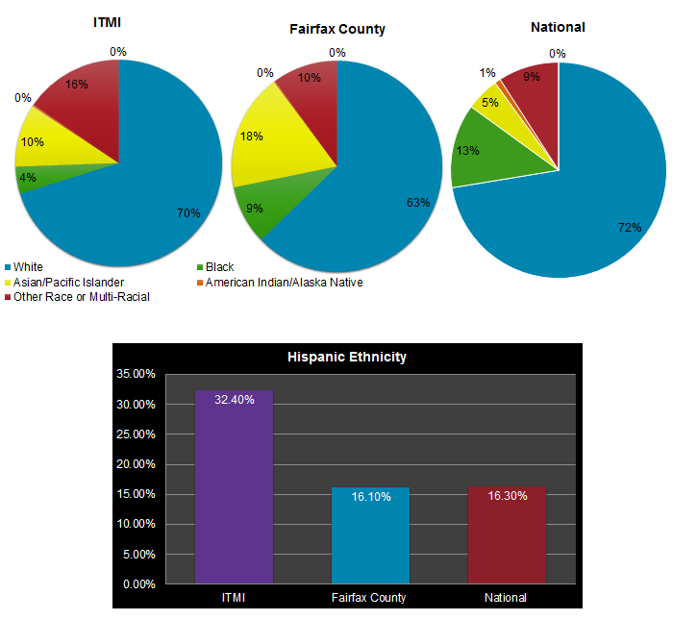
Participants’ Race/Ethnicity

